Slide 1

ADAPTING VBASBS QUEUEING MODEL FOR PROOF-OF-STAKE CONSENSUS ALGORITHM
Presented by Group 2:
Kyle Kentner Nathan Crosby Andrew Smith Sush Chittibabu Abdulla Karjikar
Notes:
Andrew

Slide 2



Introduction
Notes:
Andrew This work aims to establish a theoretical model to simulate how blockchain transactions are grouped, validated, processed, and purged from a network based on a proof-of-stake consensus algorithm. Originally blockchain utilized a proof-of-work concept which established a means of validating incoming transactions through a distributed network of participants. Such solutions implemented methods with a focus on the accuracy and redundancy of the various transactions with minimal effort given to reduce individual transactional waiting time and increase the efficiency of processing transactions. This approach remains true for Bitcoin; however, Ethereum changed this consensus mechanism in 2022 with the update to proof-of-stake. This changed the blockchain to be more efficient in reducing complexity in the work computations while decreasing the barrier to entry hence providing reduced centralized risk with the potential of more nodes securing the network. Where under the proof-of-work consensus algorithm, the timing of blocks was determined by the mining difficulty, the new approach, proof-of-stake, the timing is fixed. Time in the Ethereum proof-of-stake consensus algorithm is divided into twelve second increments in which a block is created.

Slide 3

Related Works
The slow transaction rates with proof-of-work consensus algorithms have been a major issue for cryptocurrencies.
Fu [1] focuses on improving blockchain optimization and increasing throughput.
Mechkaroska [3] explores different methods to increase throughput, including increasing the block size and sharding.
Sharding is a technique for parallel processing of transactions and has been implemented in Zilliqa [8].
Gobel, Thakkar, and Mechkaroska [2], [3], [9] have suggested increasing the block size as a solution, but this lacks creativity.
Ethereum transitioned to a proof-of-stake consensus algorithm in 2022, which requires a new theoretical model to be considered.
This paper focuses on exploring the ramifications of the new consensus algorithm in a theoretical context, using the VBASBS model proposed by Seol, et al. as a basis [7].
Notes:
Sush:

Slide 4
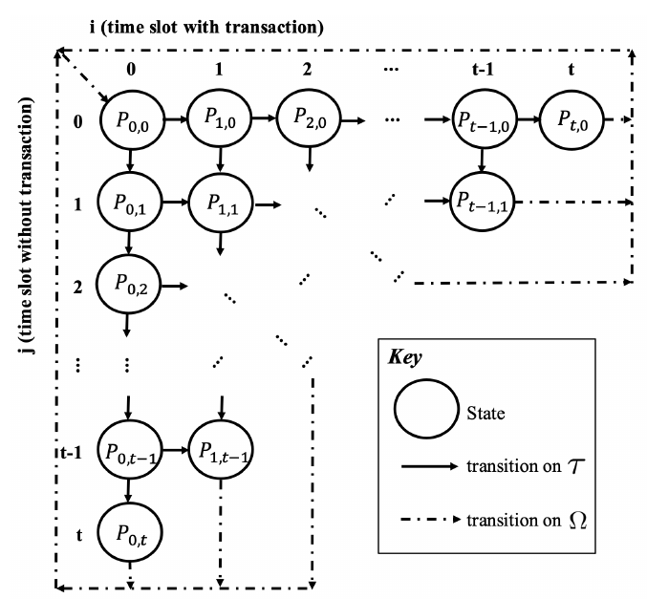
Methodology
Notes:
Nathan

Slide 5

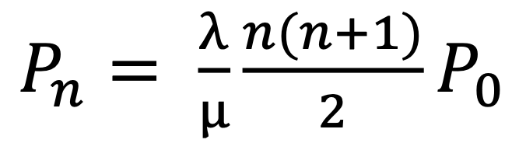
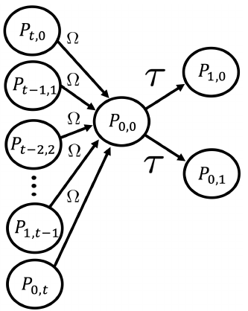
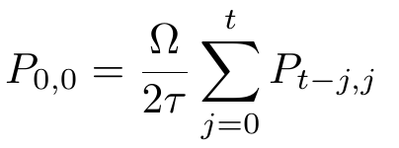
Methodology
Original Performance Model – Blocksize is fixed and block is processed when all of the transaction slots in the block have been filled. [7]
New Performance Model – Time
between blocks being processed is
fixed and block size fluctuates
depending on transactions seen in
the block window of time.
Notes:
Nathan:

Slide 6
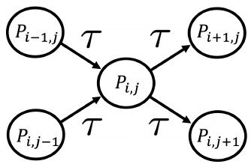



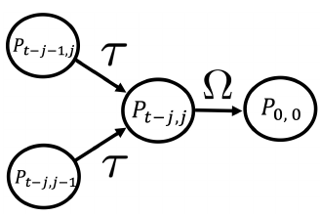

Methodology
Interior State
Final State
Notes:
Nathan:

Slide 7

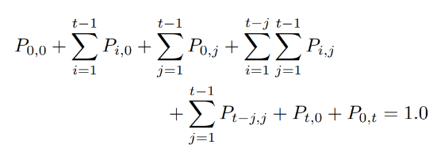
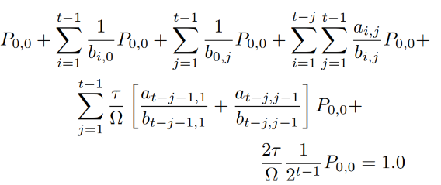
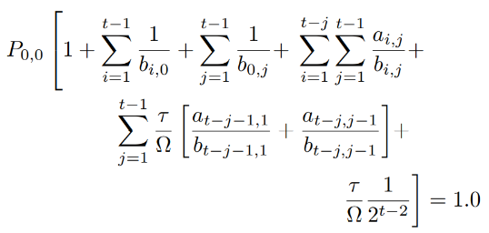
Methodology
Markovian Queueing Constraint
Accounting for separate cases
Substituting to get equations in terms of P_{0,0}
Factoring out P_{0,0}
Notes:
Nathan:

Slide 8

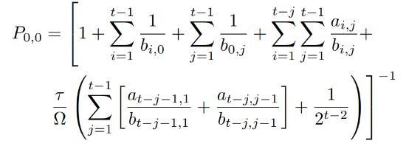
Methodology
Solution for P_{0,0}
Because every state may be expressed in terms of P_{0,0}, the remainder of the probabilities for the state space may then be determined.
Notes:
Nathan:

Slide 9
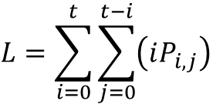
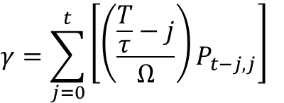
Methodology
Metrics
$$γ=\sum_{j=0}^{t}{\left[\left(\frac{\frac{T}{τ}−j}{Ω}\right)P_{t−j,j}\right]}$$
(Average Throughput)
$$L=\sum_{i=0}^{t}{\sum_{j=0}^{t−i}{\left(iP_{i,j}\right)}}$$
(Average Filled Slots)
These probabilities may then be used to calculate the average performance of the system with respect to several key metrics.
Notes:
Nathan:

Slide 10
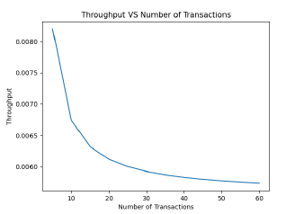
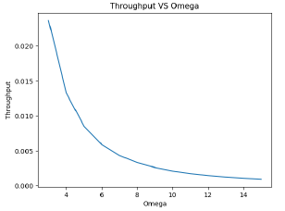
Results
Varying number of transaction time slices (t) in the network with constant block window time (T) and processing time (Omega) to examine changes in throughput
Varying time taken to post and purge the block in the network (Omega) with constant block window time (T) and number of time slices (t) to examine changes in average filled slots
Notes:
Abdulla:

Slide 11
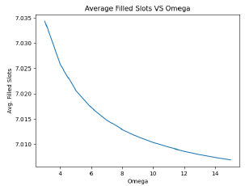
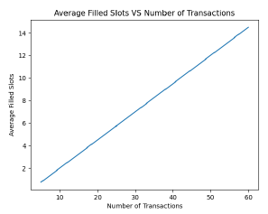
Results
Varying number of transaction time slices (t) in the network with constant block window time (T) and processing time (Omega) to examine changes in average filled slots
Varying time taken to post and purge the block in the network with constant block window time (T) and number of time slices (t) to examine changes in throughput
Notes:
Abdulla

Slide 12

Conclusion
This model proposes a blockchain system utilizing a deadline system based on Proof of Stake
Discrete time steps allow probabilities for the state space to be calculated for variable blocksizes
Results of increasing the time window for building blocks produced mostly intuitive results
Potential for optimization of time window
Notes:
Andrew:
In this work we have demonstrated a new framework to theoretically describe proof-of-stake blockchain networks, and have created Python code to simulate efficiency metrics when certain independent variables are varied. This work could be used in the future to optimize the block window of time based on the expected empty transaction time slices (j) to be seen in the next block window of time based off of past history and the cyclical nature of transaction activity.

Slide 13
Questions?
Notes:
Team

Slide 14
References
[1] X. Fu, R. Yu, J. Wang, Q. Qi, and J. Liao, “Performance optimization
for blockchain-enabled distributed network function virtualization management and orchestration,” IEEE Transactions on Vehicular Technology, 2020.
[2] J. Gobel and A. E. Krzesinski, “Increased block size and bitcoin “blockchain dynamics,” in 2017 27th International Telecommunication Networks and Applications Conference (ITNAC). IEEE, 2017, pp. 1–6.
[3] D. Mechkaroska, V. Dimitrova, and A. Popovska-Mitrovikj, “Analysis of the possibilities for improvement of blockchain technology,” in 2018 26th Telecommunications Forum (TELFOR). IEEE, 2018, pp. 1–4.
[4] S. Nakamoto, “Bitcoin: A peer-to-peer electronic cash system,” Bitcoin White Paper, 2008. [Online]. Available: https://bitcoin.org/bitcoin.pdf
[5] L. Pennella. Proof-of-stake (pos). https://ethereum.org/en/developers/docs/consensus-mechanisms/pos/. Accessed:04-11-2023, Last Edit: Luca Pennella on 04-07-2023.
[6] M. Platt, J. Sedlmeir, D. Platt, J. Xu, P. Tasca, N. Vadgama, and J. I. Ibanez, “The energy footprint of blockchain consensus mechanisms beyond proof-of-work,” in 2021 IEEE 21st International Conference on
Software Quality, Reliability and Security Companion (QRS-C). IEEE, 2021, pp. 1135–1144.
[7] J. Seol, A. Kancharla, Z. Ke, H. Kim, and N. Park, “A variable bulk arrival and static bulk service queueing model for blockchain,” in Proceedings of the 2nd ACM International Symposium on Blockchain and Secure Critical
Infrastructure, 2020, pp. 63–72.
[8] Z. Team et al., “The zilliqa technical whitepaper,” Zilliqa Whitepaper, 2017.
[9] P. Thakkar, S. Nathan, and B. Viswanathan, “Performance benchmarking and optimizing hyperledger fabric blockchain platform,” in 2018 IEEE 26th International Symposium on Modeling, Analysis, and Simulation of Computer and Telecommunication Systems (MASCOTS). IEEE, 2018, pp. 264–276.

